Slide 1
Supervised Learning Setup
Dept. of Computer Science
Faculty of Science and Technology
Lecturer No: |  | Week No: | 2 | Semester:
Instructor: | Prof. Dr. Kamruddin Nur (kamruddin@aiub.edu)

Slide 2
Supervised Learning
Training experience: a set of labeled examples of the form
x = ( x₁, x₂, …, x_{n}, y )
where x_{j} are values for input variables and y is the output
This implies the existence of a “teacher” who knows the right answers
What to learn: A function f : X₁ × X₂ × … × X_{n} → Y , which maps the input variables into the output domain
Goal: minimize the error (loss function) on the training examples

Slide 3

Supervised Learning Problem
Given a data set D X₁ × X₂ × … × X_{n} × Y, find a function
  h : X₁ × X₂ × … × X_{n} → Y
  such that h(x) is a good predictor for the value of y
  h is called a hypothesis
Example: Suppose have a dataset D with:
  Input features (X₁, X₂, …, Xₙ): These are the variables used to make predictions.
  (Example: In house price prediction, X₁ = size, X₂ = location, etc.)
  Output/target (Y): This is what you want to predict.
  (Example: House price, whether an email is spam, etc.)
Goal: Find a function h (called a hypothesis) that takes X₁, X₂, …, Xₙ as input and predicts Y accurately.
What is h? (The Hypothesis)
h is just a rule or model that makes predictions.
(Example: A linear equation like h(X) = 2X + 3 could predict house prices.)
"Good predictor" means h(X) should be close to the true Y (measured by accuracy, error, etc.).

Slide 4
Supervised Learning Problem
If Y is the real set, this problem is a regression
If Y is a finite discrete set, this problem is called classification
Case 1: Regression (Y is a real number)
  Y is continuous (any numeric value).
  (Example: Predicting house prices, temperature, etc.)
  Example Hypothesis:
  h(size, location) = 50,000 + 200*(size) + 10,000*(location_rating)
Case 2: Classification (Y is discrete)
  Y is a category (like labels).
  (Example: Spam/Not spam, Cat/Dog/Bird, etc.)
  Binary Classification (2 classes):
  Y = {0, 1} or {Spam, Not Spam}.
  (Example: h(email_text) = "Spam" or "Not Spam".)
  Multiclass Classification (>2 classes):
  Y = {Cat, Dog, Bird, ...}.
  (Example: h(image) = "Cat".)

Slide 5
Supervised Learning Steps
Decide what the training examples are
  Data collection
  Feature extraction or selection:
    Discriminative features
    Relevant and insensitive to noise
  Input space X, output space Y, and feature vectors
Choose a model, i.e. representation for h;
  or, the hypothesis class H = {h₁, …, h_{r}})
Choose an error function to define the best hypothesis
Choose a learning algorithm: regression or classification method
  Training
  Evaluation = testing

Slide 6
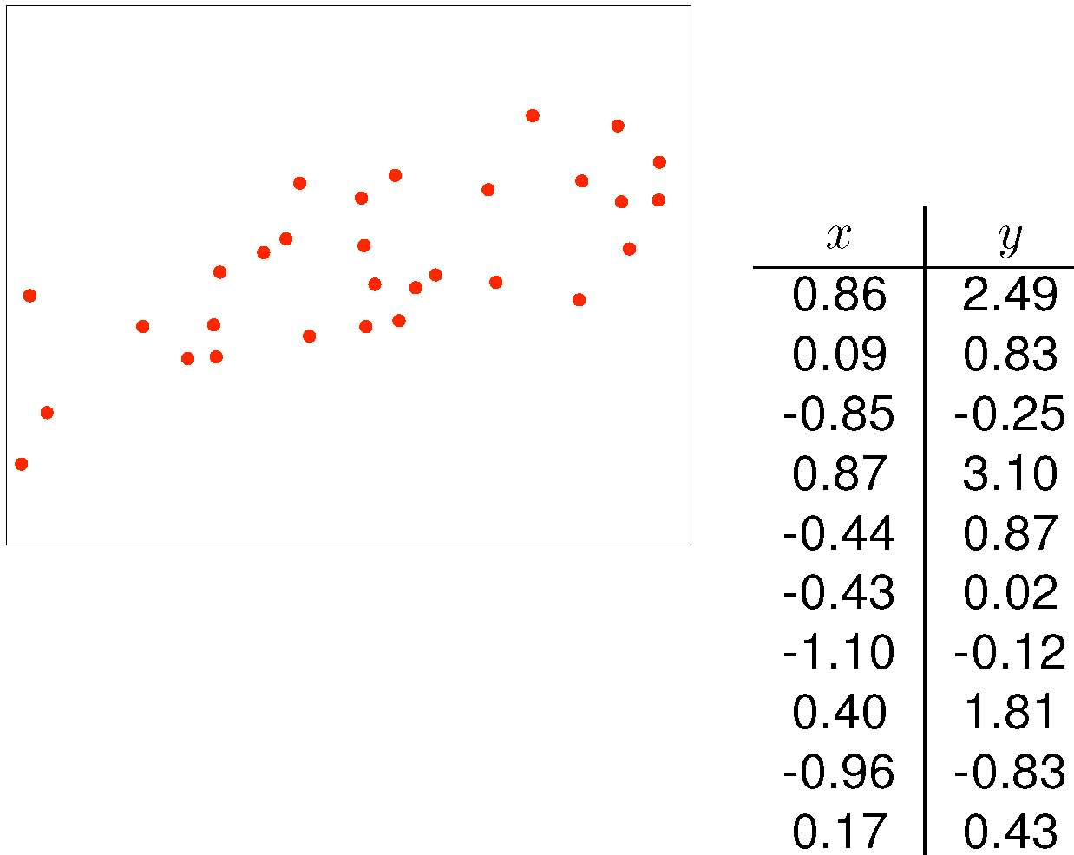
EX: What Model or Hypothesis Space H ?
Training examples:
  e_{i} = <x_{i}, y_{i}>
  for i = 1, …, 10

Slide 7
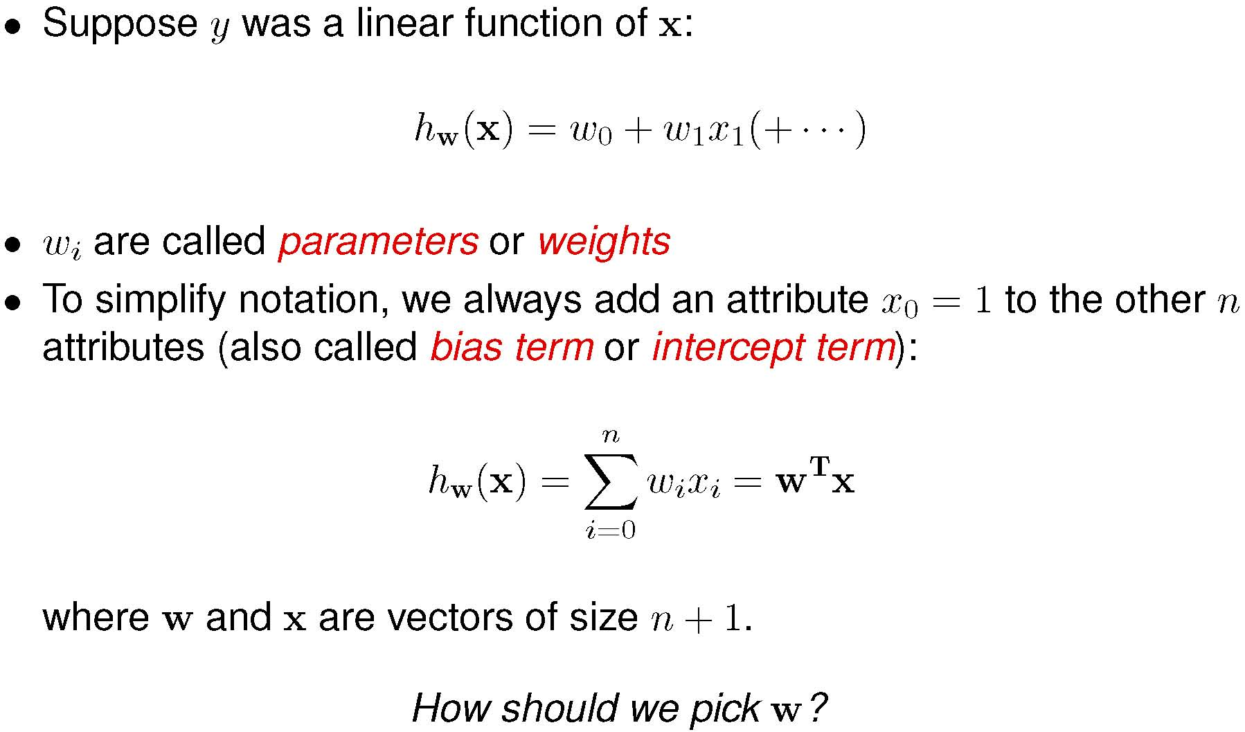
Linear Hypothesis

Slide 8
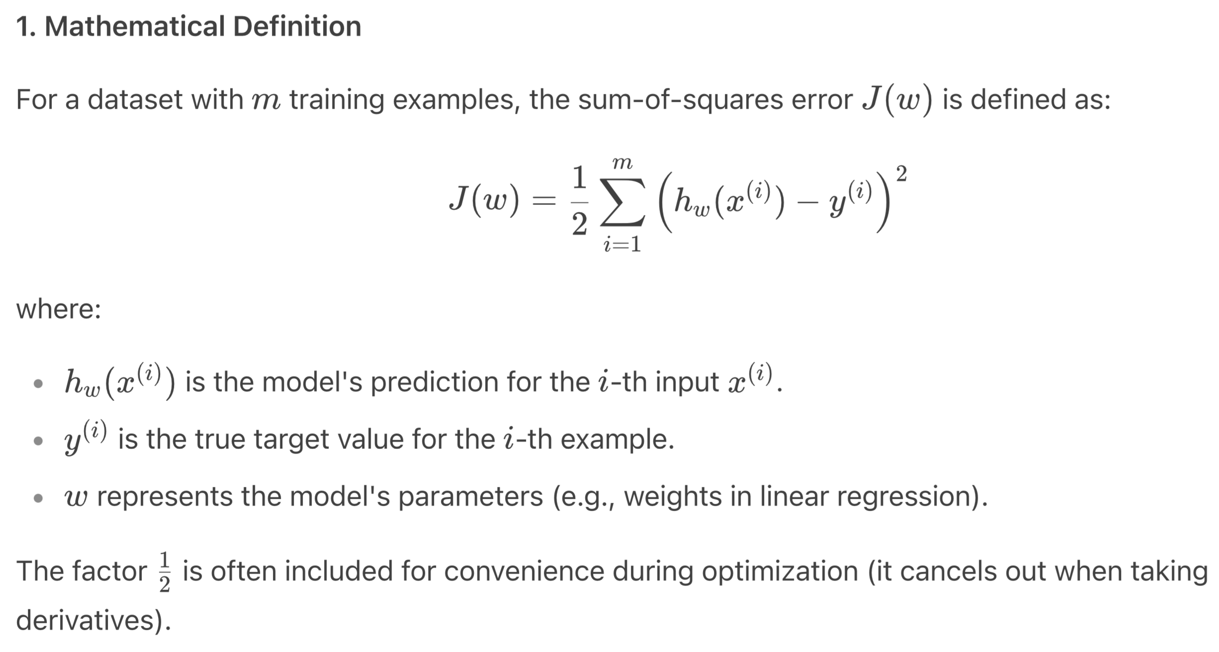
Sum-of-Squares Error function
(or Mean Squared Error, MSE)
Should define the error function to measure the difference between the predictions and the true answers?
How to find prediction errors?
Purpose:
Quantifies Model Accuracy: Measures how well the hypothesis hw​ fits the training data.
Optimization Goal: Find the parameters ww that minimize J(w).
Notes:
1. Intuitively, w should make the predictions of h_{w} close to the true values y on the data we have

Slide 9
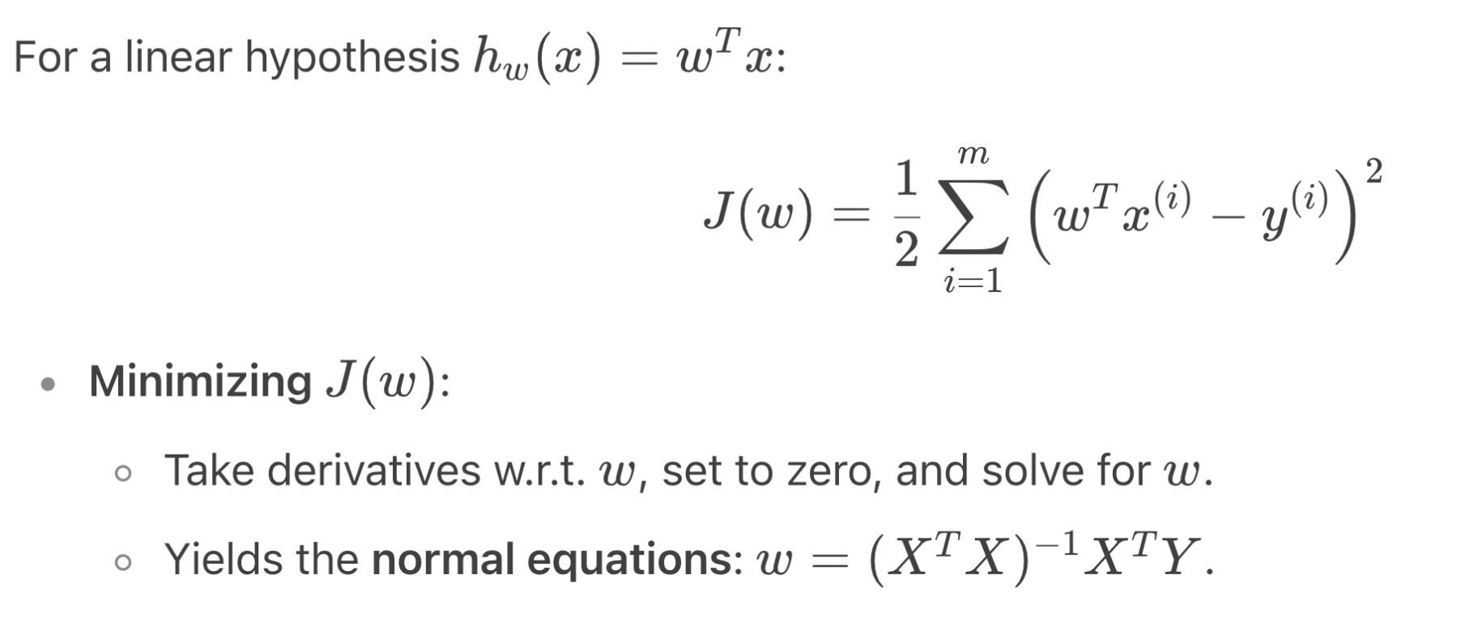
Example – Minimizing J(w)
Notes:
1. Intuitively, w should make the predictions of h_{w} close to the true values y on the data we have

Slide 10
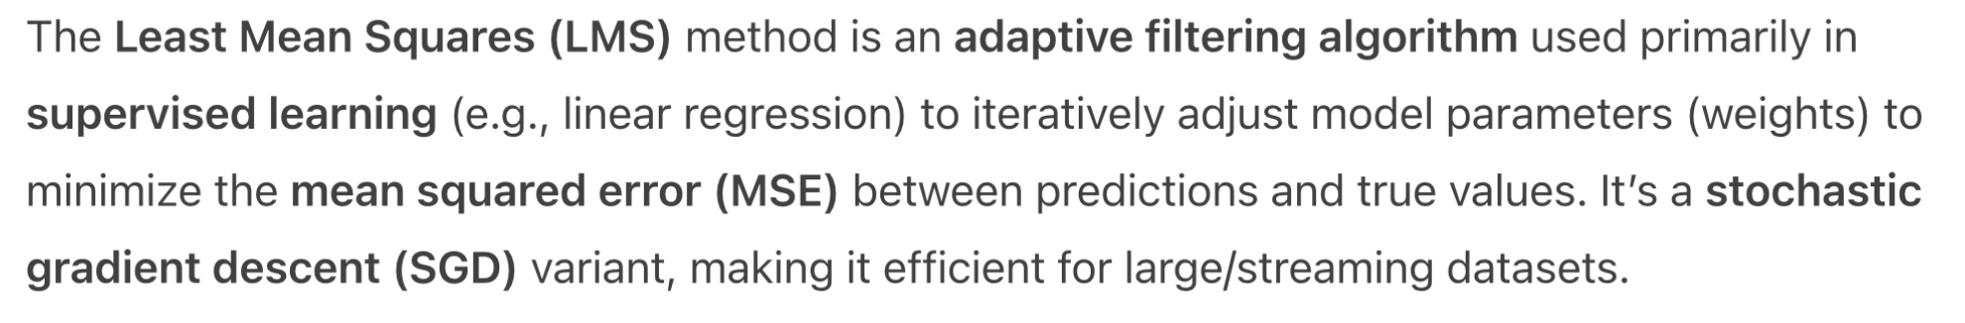
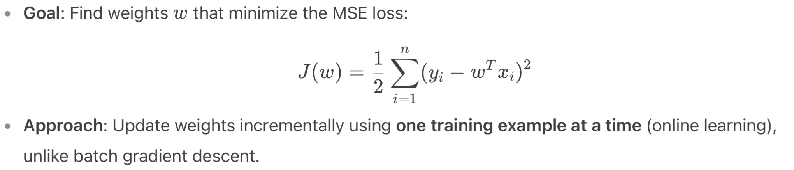
Least Mean Squares (LMS)
Notes:
1. Intuitively, w should make the predictions of h_{w} close to the true values y on the data we have

Slide 11
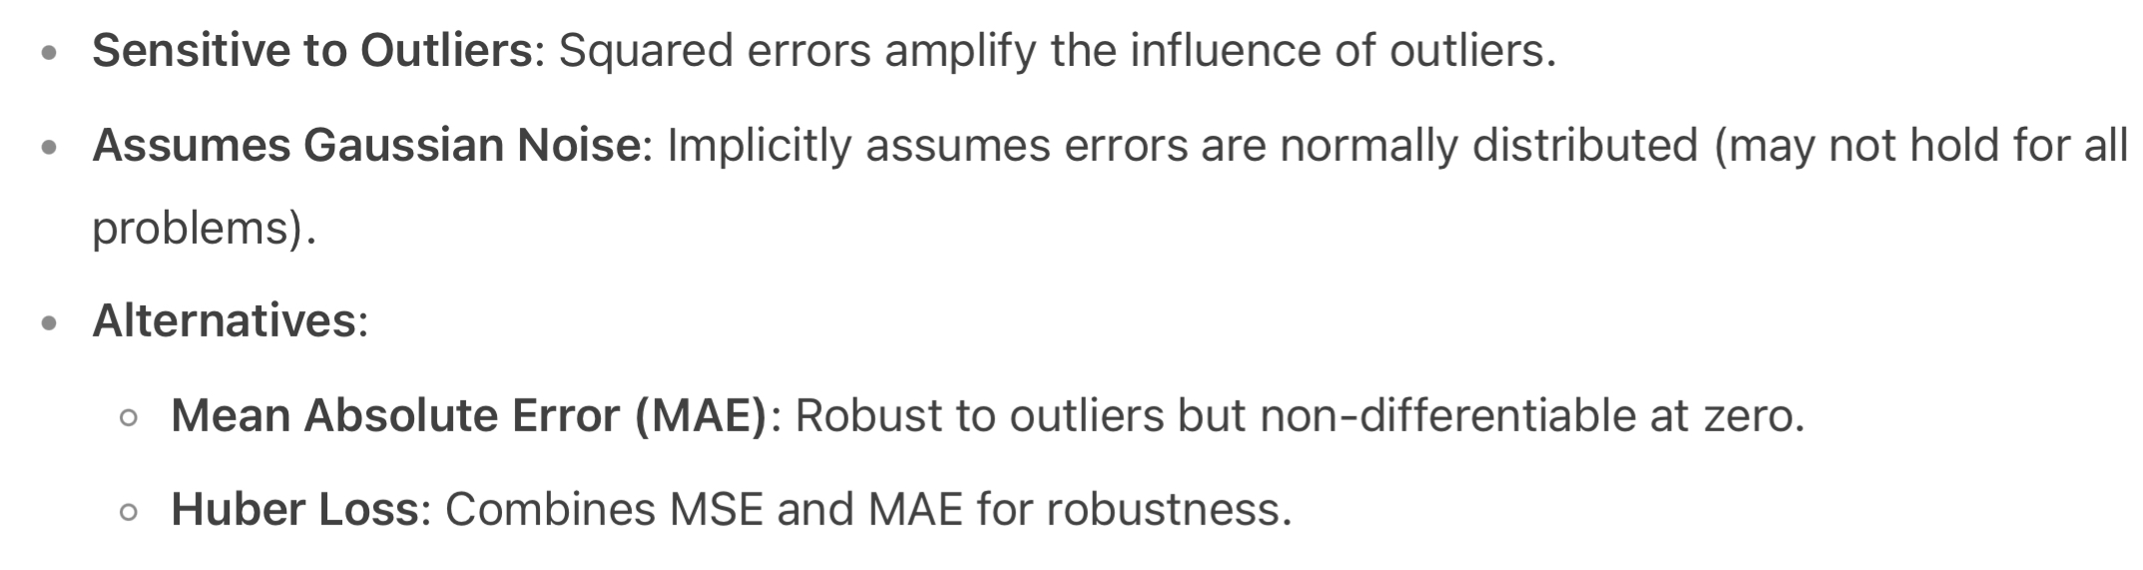
Limitation of MSE
Notes:
1. Intuitively, w should make the predictions of h_{w} close to the true values y on the data we have

Slide 12
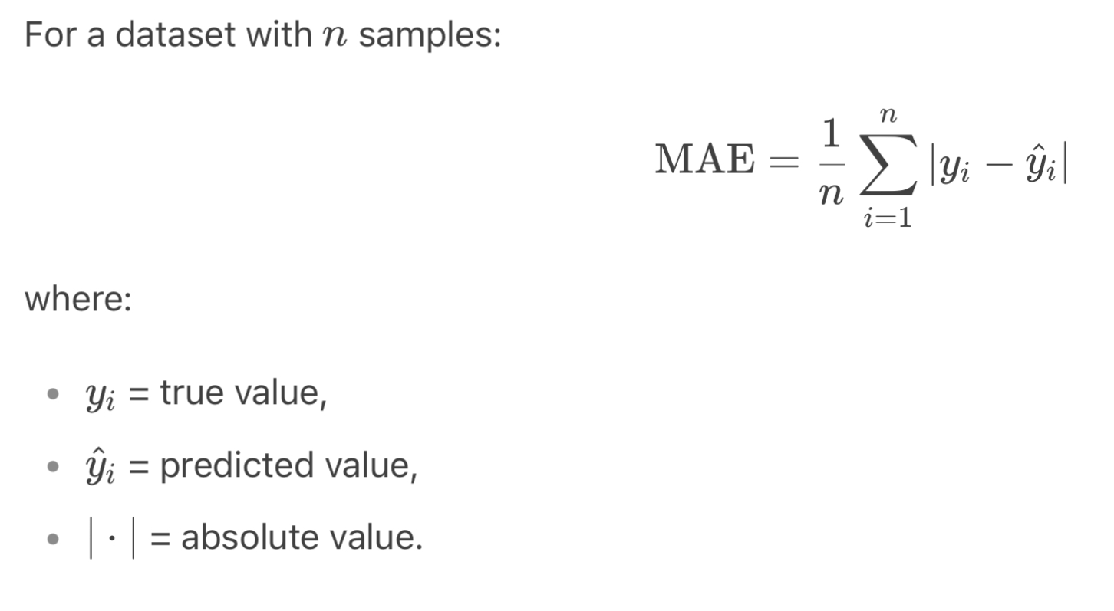
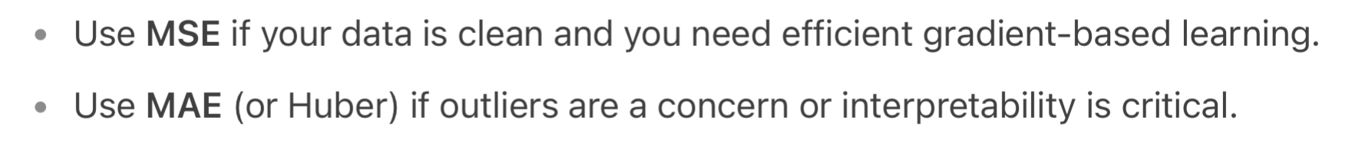
Mean Absolute Error (MAE)
Notes:
1. Intuitively, w should make the predictions of h_{w} close to the true values y on the data we have

Slide 13
Mean Absolute Error (MAE)
Notes:
1. Intuitively, w should make the predictions of h_{w} close to the true values y on the data we have

Slide 14
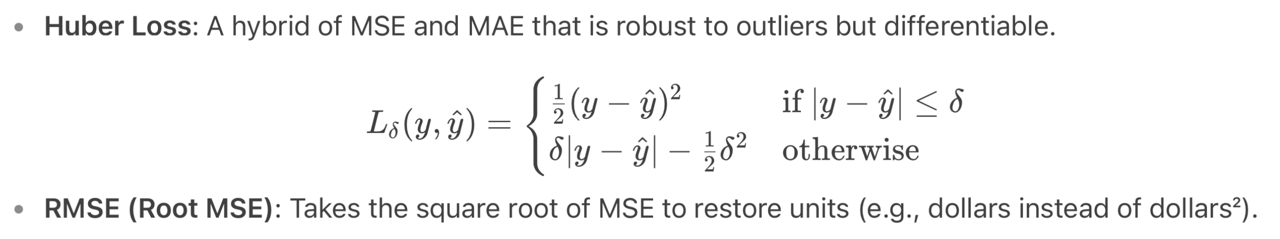
Huber Loss and RMSE
Notes:
1. Intuitively, w should make the predictions of h_{w} close to the true values y on the data we have

Slide 15
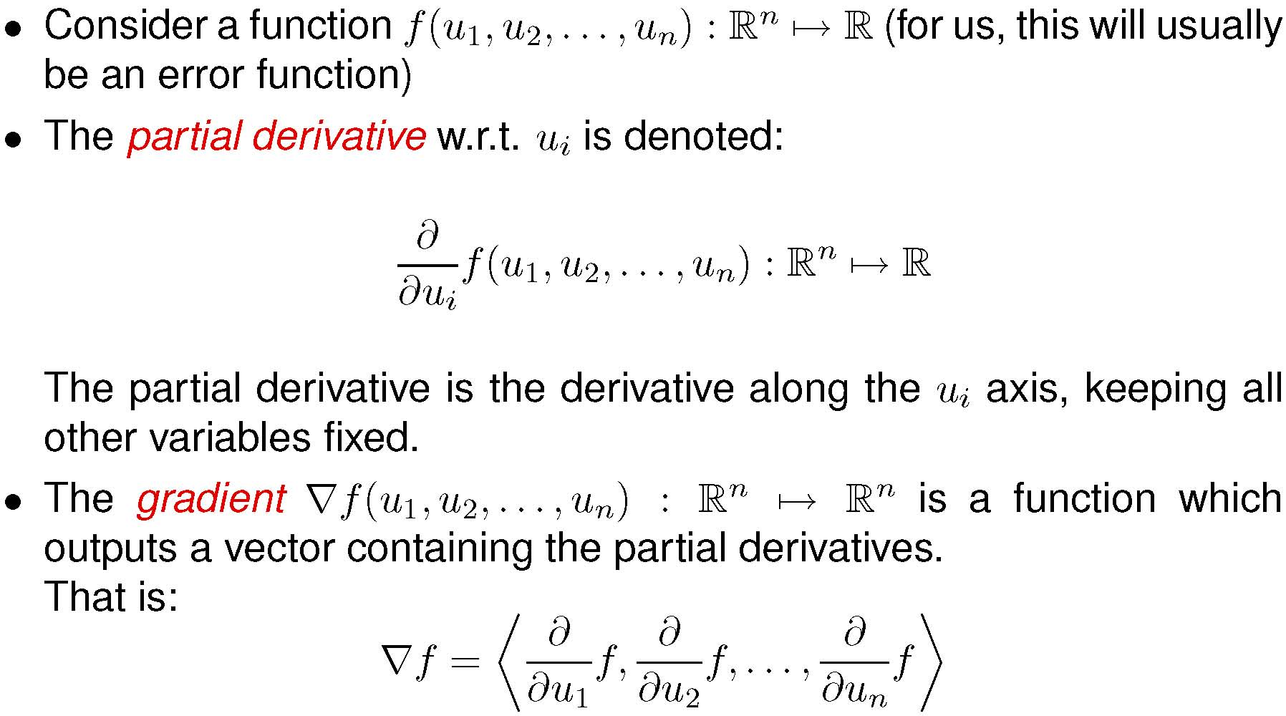
Some Linear Algebra

Slide 16
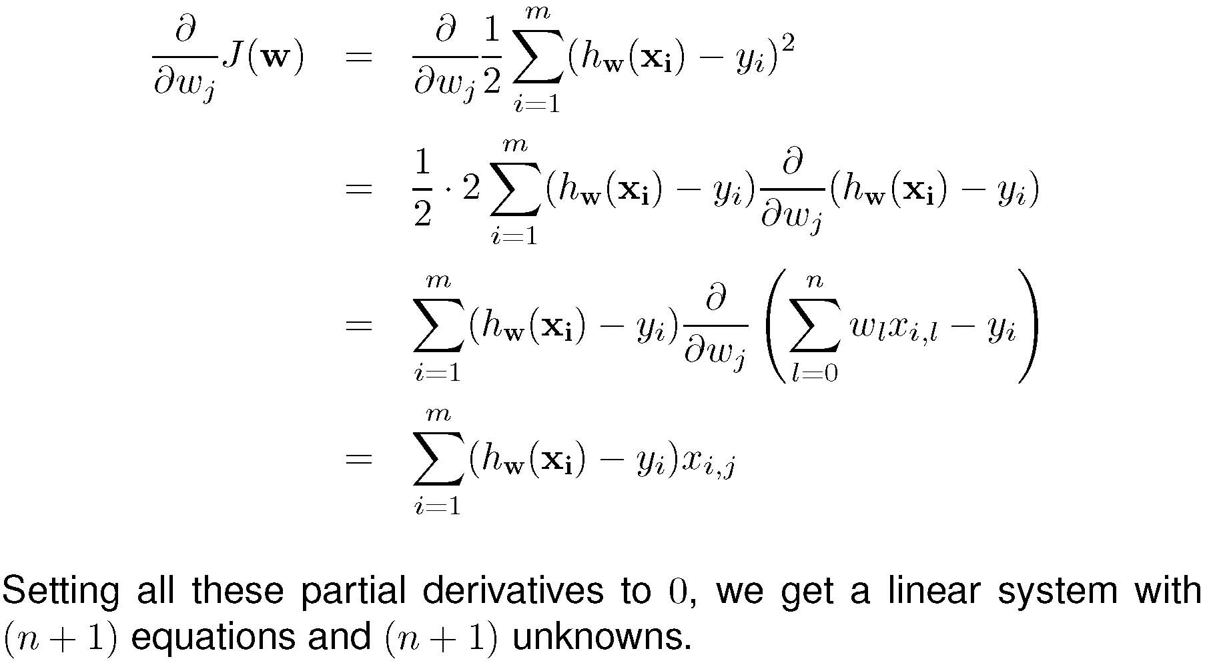
Some Linear Algebra …
Notes:
Derivative of the sum, with respect to w_{j}, is x_{ij}, and 0 otherwise.
▼J(w) = ( … ) = (0, …, 0) to obtain the solution for vector w

Slide 17
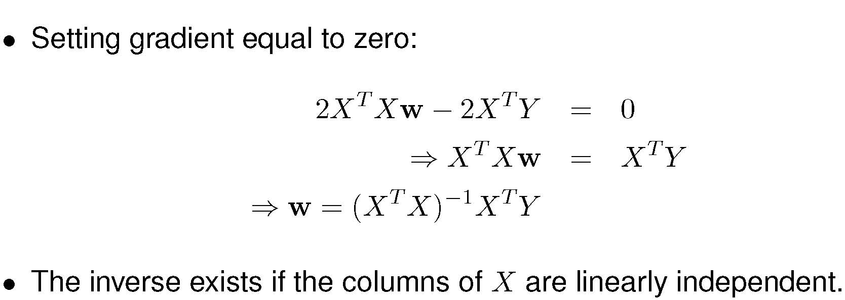
Some Linear Algebra - The Solution!
Notes:
1. The process in the previous slide can be performed as a matrix operation at once.

Slide 18
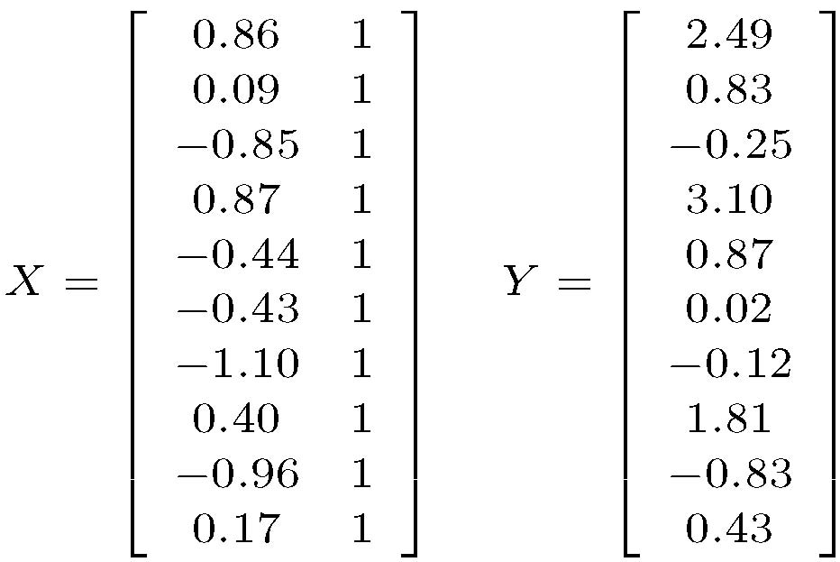
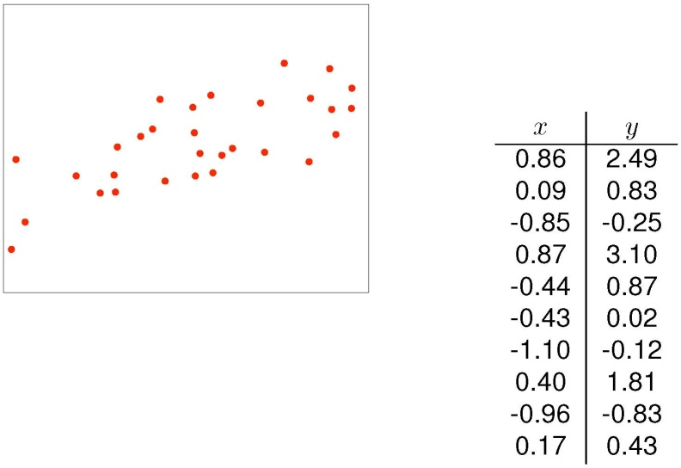
Example of Linear Regression - Data Matrices
Notes:
1. The process in the previous slide can be performed as a matrix operation at once.

Slide 19
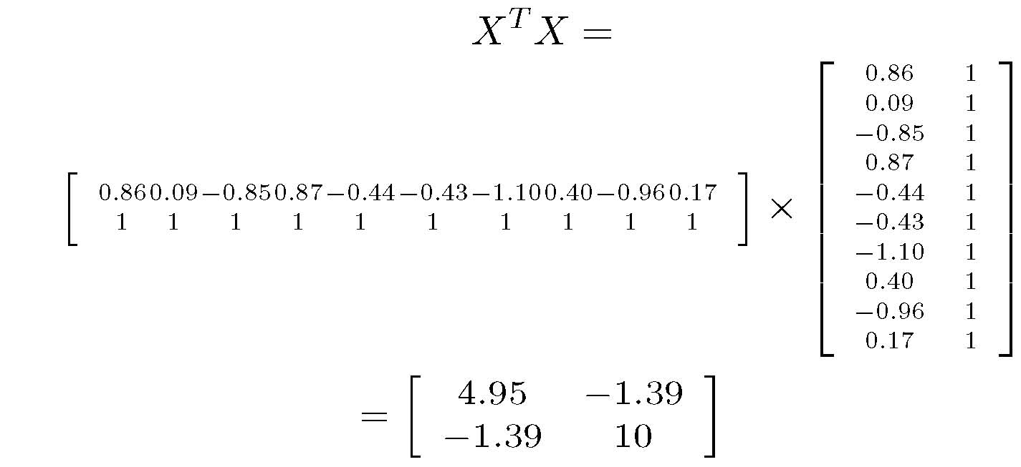
X^{T}X
Notes:
1. The process in the previous slide can be performed as a matrix operation at once.

Slide 20
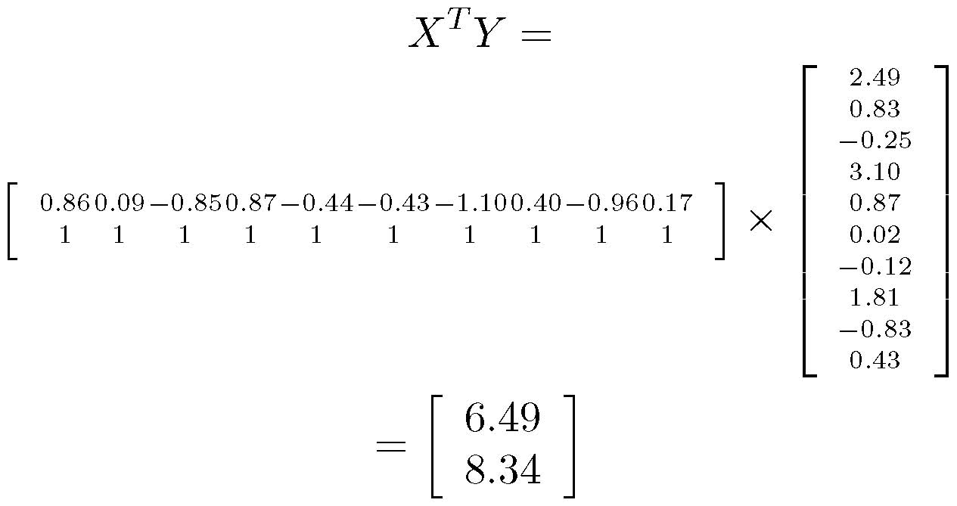
X^{T}Y
Notes:
1. The process in the previous slide can be performed as a matrix operation at once.

Slide 21
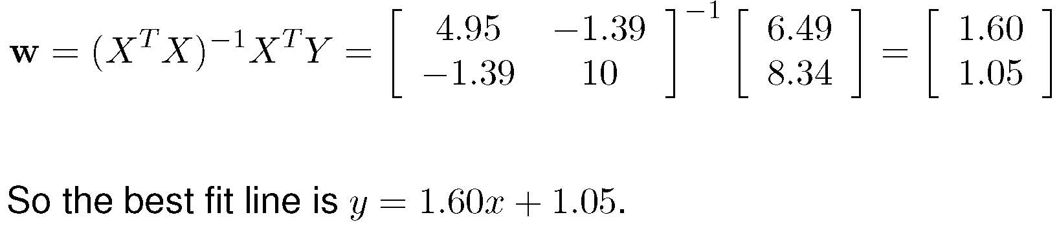
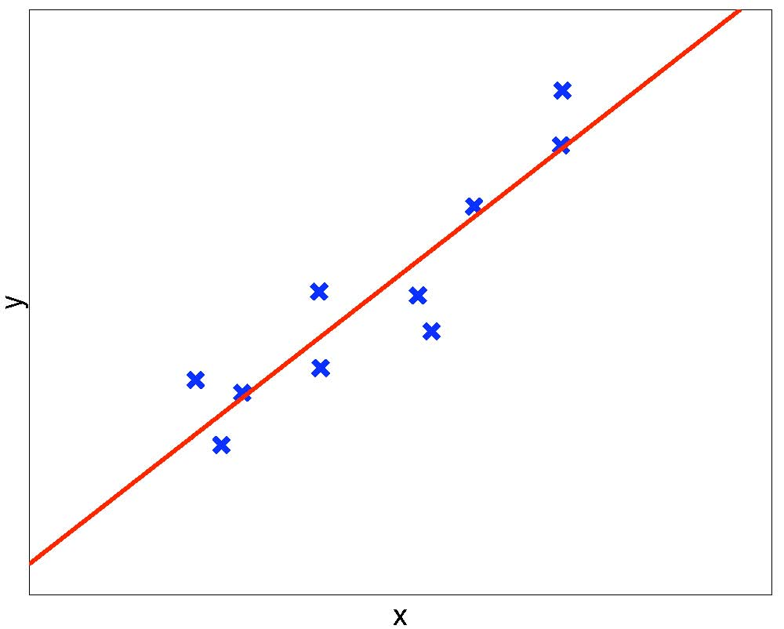
Solving for w – Regression Curve
Notes:
1. The process in the previous slide can be performed as a matrix operation at once.

Slide 22
Linear Regression - Summary
The optimal solution can be computed in polynomial time in the size of the data set.
Too simple for most real-valued problems
The solution is w = (X^{T}X)⁻¹X^{T}Y, where
  X is the data matrix, augmented with a column of 1’s
  Y is the column vector of target outputs
  A very rare case in which an analytical exact solution is possible
    Nice math, closed-form formula, unique global optimum
Problems when (X^{T}X) does not have an inverse
  Possible solutions to this:
    Include high-order terms in h_{w}
    Transform the input X to some other space X’, and apply linear regression on X’
    Use a different but more powerful hypothesis representation
Is Linear Regression enough ?

Slide 23
Generalization Ability vs Overfitting
Very important issue for any machine learning algorithms.
  Can your algorithm predict the correct target y of any unseen x ?
Hypothesis may perfectly predict for all known x’s but not unseen x’s
  This is called overfitting
Each hypothesis h has an unknown true error on the universe: J_{U}(h)
But we only measured the empirical error on the training set: J_{D}(h)
Let h₁ and h₂ be two hypotheses compared on training set D, such that we obtained the result J_{D}(h₁) < J_{D}(h₂)
  If h₂ is “truly” better, that is J_{U}(h₂) < J_{U}(h₁)
  Then your algorithm is overfitting, and won’t generalize to unseen data
  We are not interested in memorizing the training set
    In our examples, highest degree d hypotheses overfit (i.e. memorize) the data
We need methods to overcome overfitting.

Slide 24
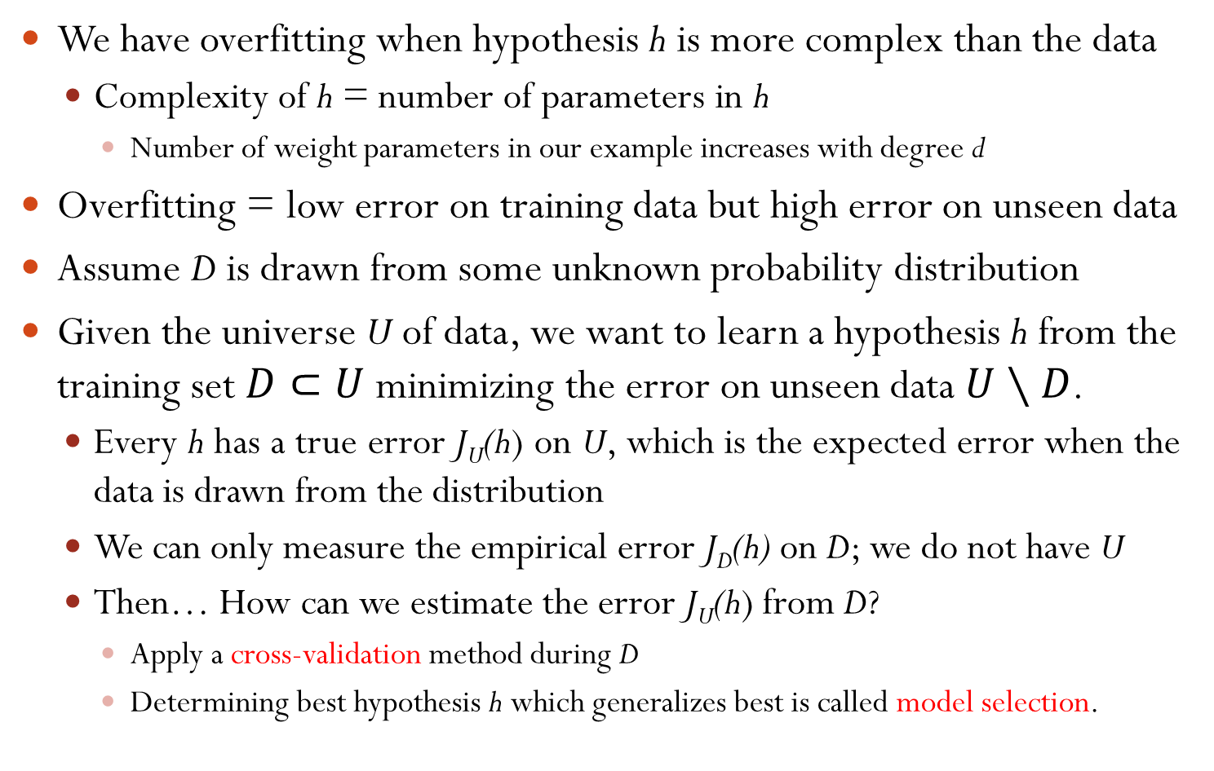
Overfitting
We have overfitting when hypothesis h is more complex than the data
  Complexity of h = number of parameters in h
    Number of weight parameters in our example increases with degree d
Overfitting = low error on training data but high error on unseen data
Assume D is drawn from some unknown probability distribution
Given the universe U of data, we want to learn a hypothesis h from the training set $D⊂U$ minimizing the error on unseen data $U∖D$.
  Every h has a true error J_{U}(h) on U, which is the expected error when the data is drawn from the distribution
  We can only measure the empirical error J_{D}(h) on D; we do not have U
  Then… How can we estimate the error J_{U}(h) from D?
    Apply a cross-validation method during D
    Determining best hypothesis h which generalizes best is called model selection.

Slide 25
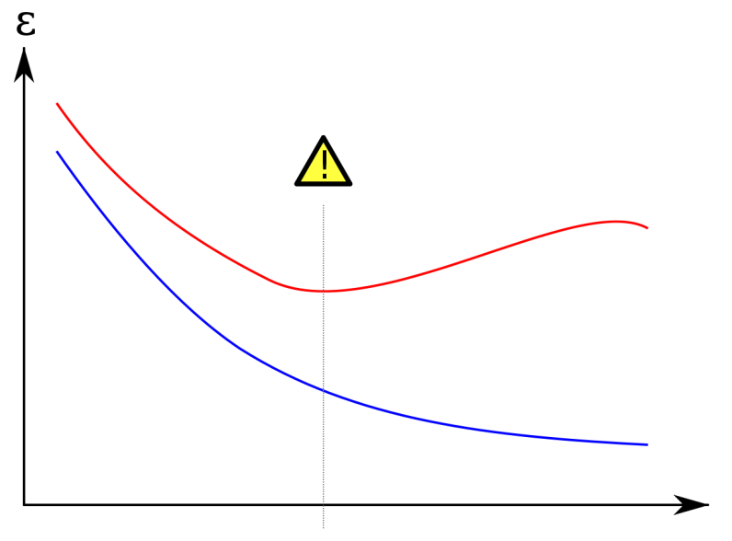
Avoiding Overfitting
Red curve = Test set
Blue curve = Training set
What is the best h?
  Find the degree d
  Such that J_{T}(h) minimal
Training error decreases with complexity of h; degree d in our example
Testing error decreases initially then increases
We need three disjoint sets of data T, V, U of D
    Learn a potential h using the training set T
    Estimate error of h using the validation set V
    Report unbiased h using the test set U

Slide 26
Cross-Validation
General procedure for estimating the true error of a learner.
Randomly partition the data into three subsets:
  Training Set T: used only to find the parameters of classifier, e.g. w.
  Validation Set V: used to find the correct hypothesis class, e.g. d.
  Test Set U: used to estimate the true error of your algorithm
These three sets do not intersect, i.e. they are disjoint
Repeat cross-validation many times
Results are averaged to give true error estimate.

Slide 27
Cross-Validation and Model Selection
How to find the best degree d which fits the data D the best?
Randomly partition the available data D into three disjoint sets; training set T, validation set V, and test set U, then:
  Cross-validation: For each degree d, perform a cross-validation method using T and V sets for evaluating the goodness of d.
      Some cross-validation techniques to be discussed later
  Model Selection: Given the best d found in step 1, find h_{w,d} using T and V sets and report the prediction error of h_{w,d} using the test set U
      Some model selection approaches to be discussed later.
The prediction error on U is an unbiased estimate of the true error

Slide 28
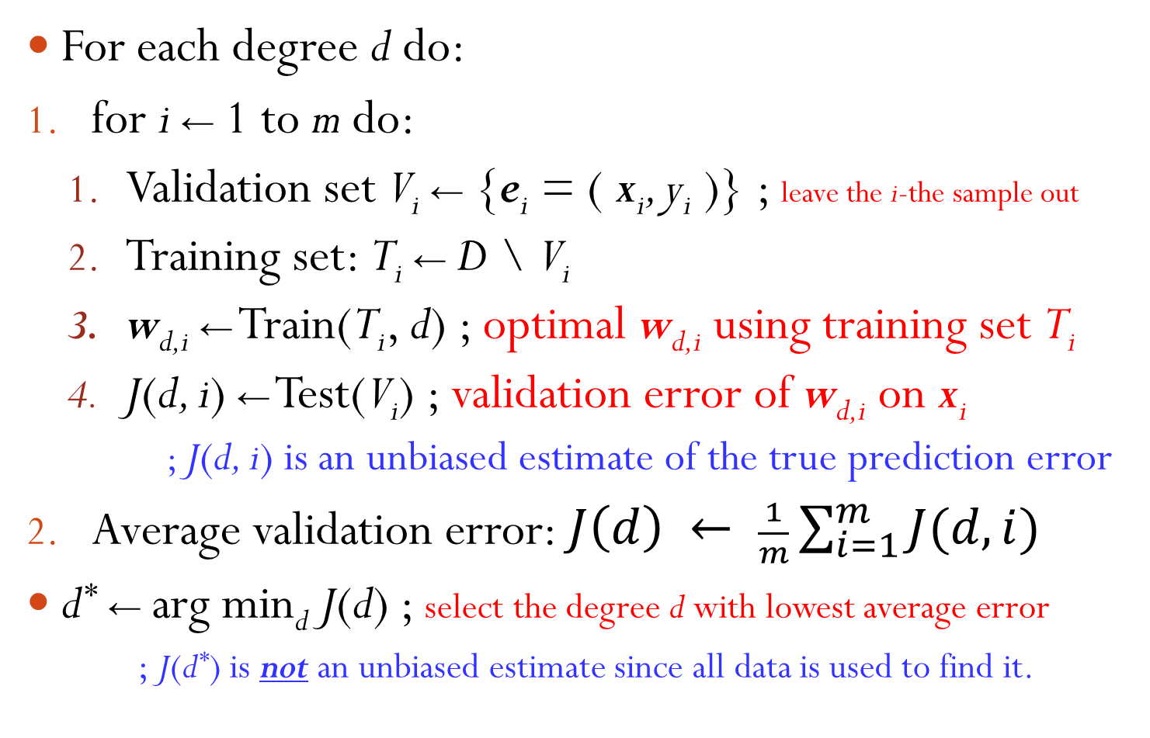
Leave-One-Out Cross-Validation
For each degree d do:
for i ← 1 to m do:
  Validation set V_{i} ← {e_{i} = ( x_{i}, y_{i} )} ; leave the i-the sample out
  Training set: T_{i} ← D \ V_{i}
  w_{d,i} ← Train(T_{i}, d) ; optimal w_{d,i} using training set T_{i}
  J(d, i) ← Test(V_{i}) ; validation error of w_{d,i} on x_{i}
        ; J(d, i) is an unbiased estimate of the true prediction error
Average validation error: $J\left(d\right) ← \frac{1}{m}\sum_{i=1}^{m}{J(d, i)}$
d* ← arg min_{d} J(d) ; select the degree d with lowest average error
      ; J(d*) is not an unbiased estimate since all data is used to find it.

Slide 29
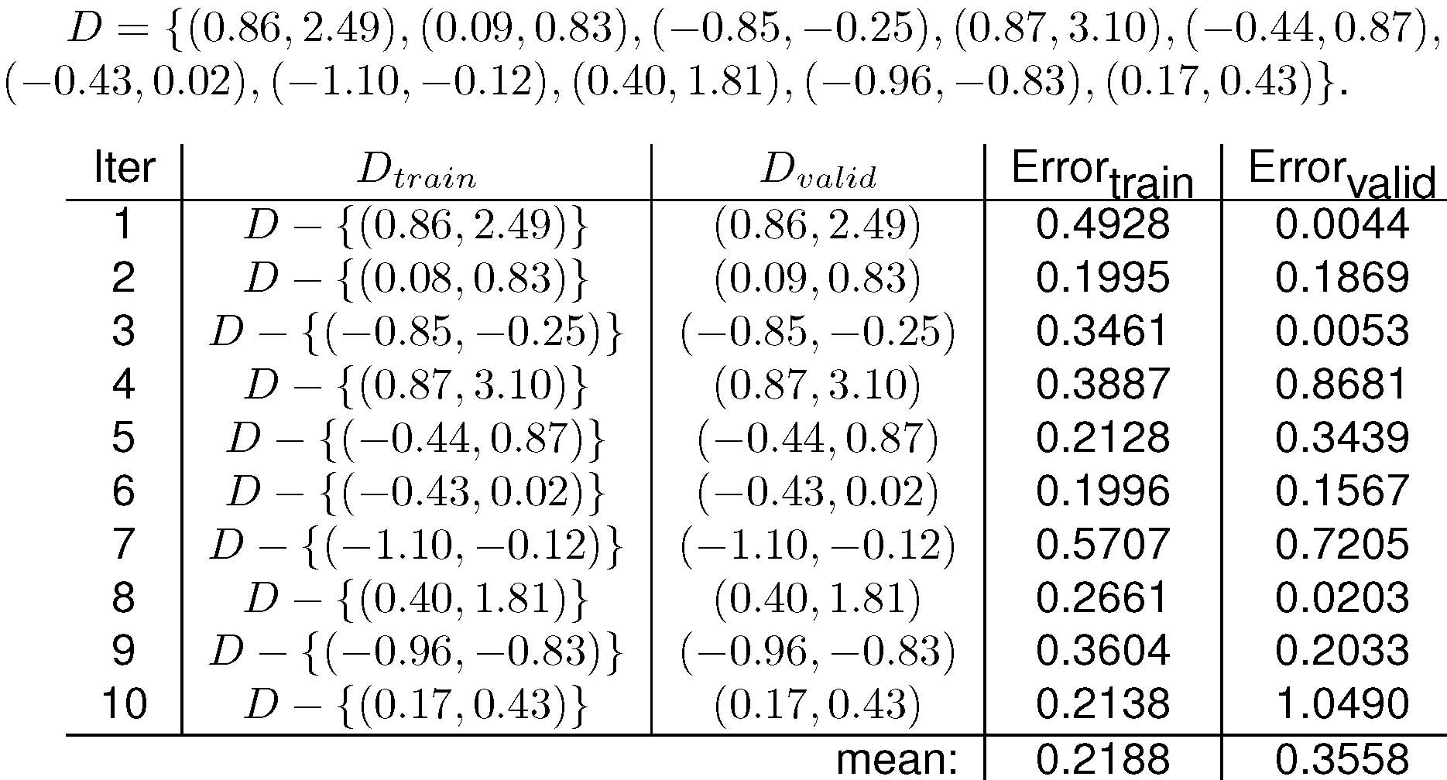
Example: Estimating True Error for d = 1

Slide 30
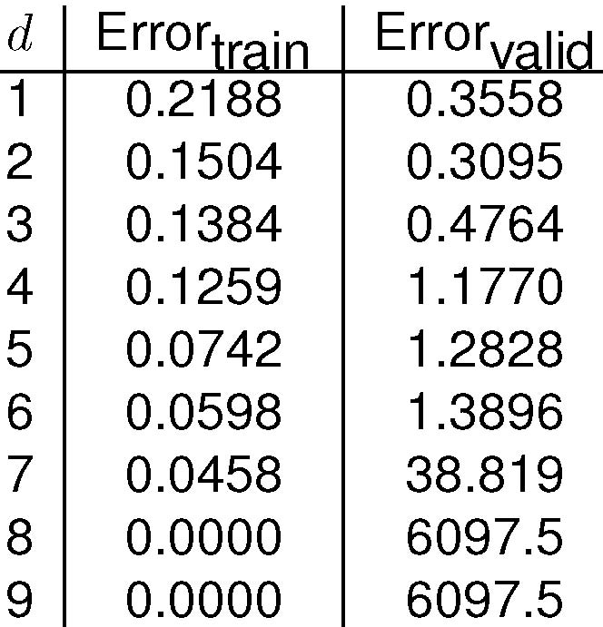
Example: Estimation results for all d
  Optimal choice is d = 2
  Overfitting for d > 2
  Very high validation error for d = 8 and 9

Slide 31
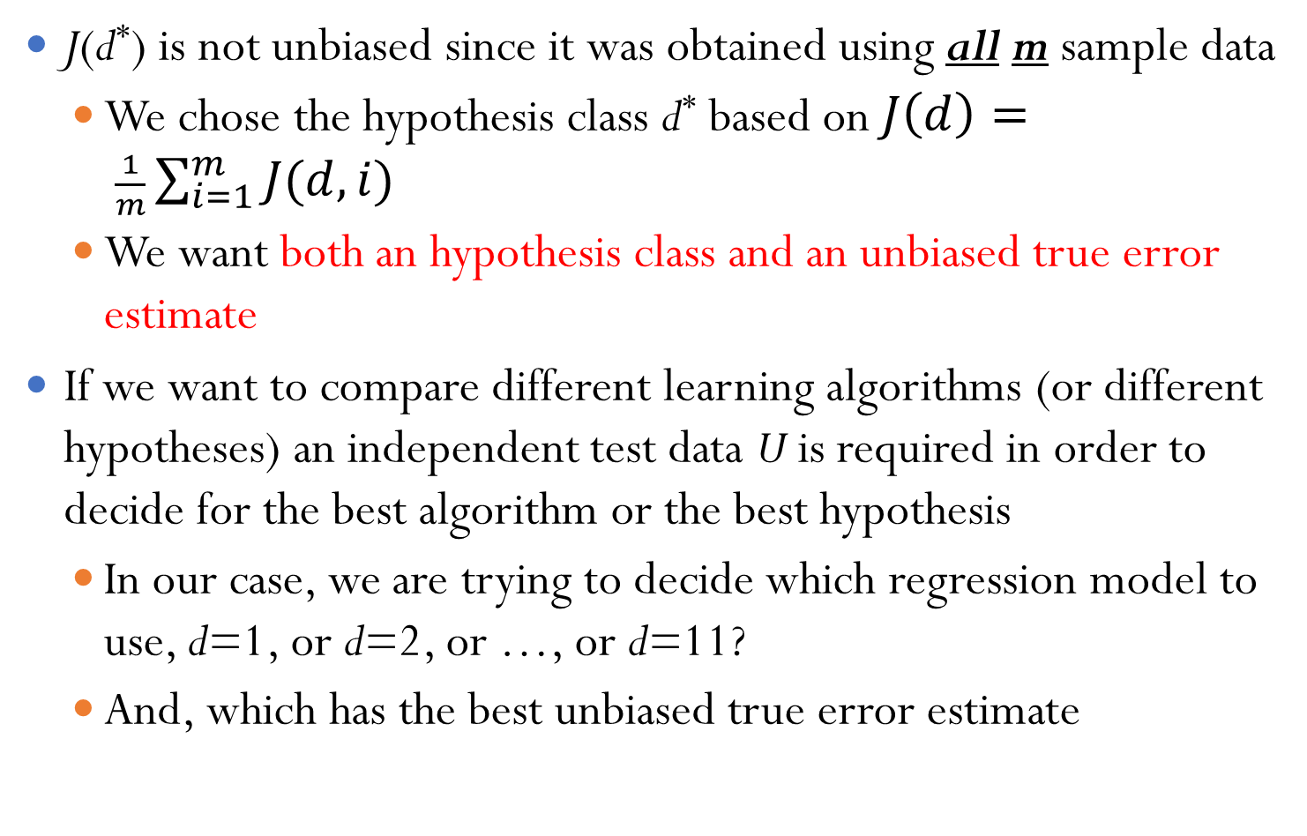
Model Selection
J(d*) is not unbiased since it was obtained using all m sample data
  We chose the hypothesis class d* based on $J\left(d\right)= \frac{1}{m}\sum_{i=1}^{m}{J(d, i)}$
  We want both an hypothesis class and an unbiased true error estimate
If we want to compare different learning algorithms (or different hypotheses) an independent test data U is required in order to decide for the best algorithm or the best hypothesis
  In our case, we are trying to decide which regression model to use, d=1, or d=2, or …, or d=11?
  And, which has the best unbiased true error estimate

Slide 32
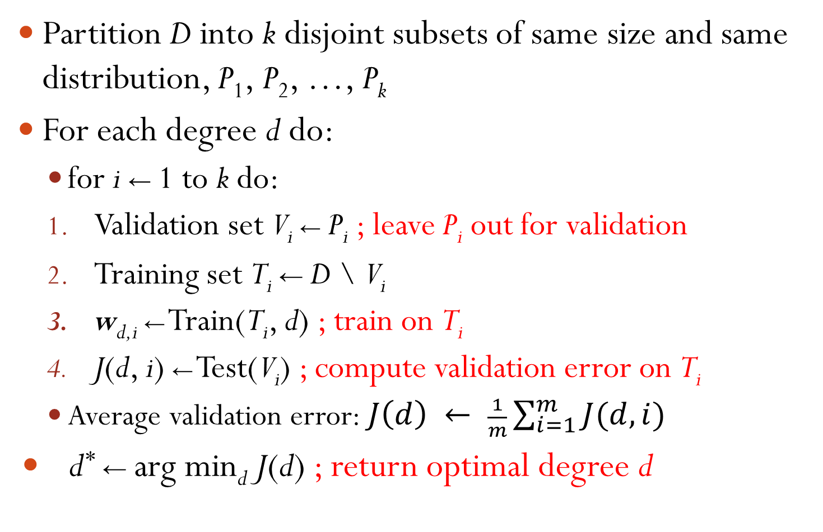
k-Fold Cross-Validation
Partition D into k disjoint subsets of same size and same distribution, P₁, P₂, …, P_{k}
For each degree d do:
  for i ← 1 to k do:
  Validation set V_{i} ← P_{i} ; leave P_{i} out for validation
  Training set T_{i} ← D \ V_{i}
  w_{d,i} ← Train(T_{i}, d) ; train on T_{i}
  J(d, i) ← Test(V_{i}) ; compute validation error on T_{i}
  Average validation error: $J\left(d\right) ← \frac{1}{m}\sum_{i=1}^{m}{J(d, i)}$
d* ← arg min_{d} J(d) ; return optimal degree d
Notes:
1. What if we have more features for each input x?

Slide 33
Learning a Class from Examples
Class C of a “family car”
  Prediction: Is car x a family car?
  Knowledge extraction: What do people expect from a family car?
Output:
  Positive (+) and negative (–) examples
Input representation:
x₁: price, x₂ : engine power

Slide 34
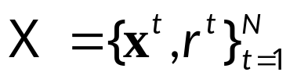
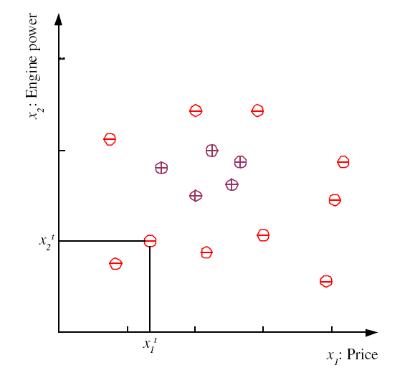
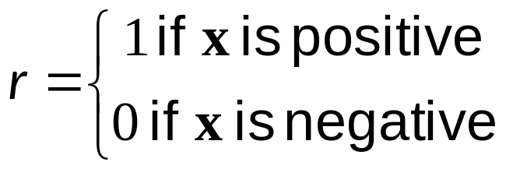
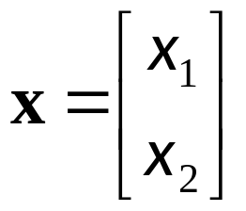
Training set X

Slide 35
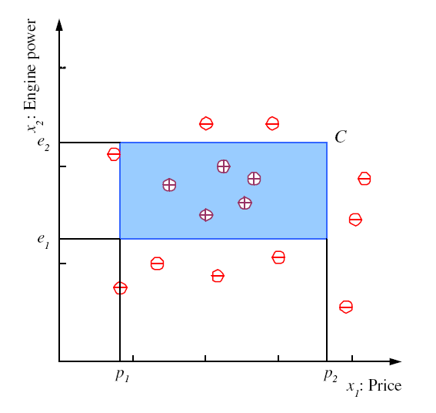
Class C

Slide 36
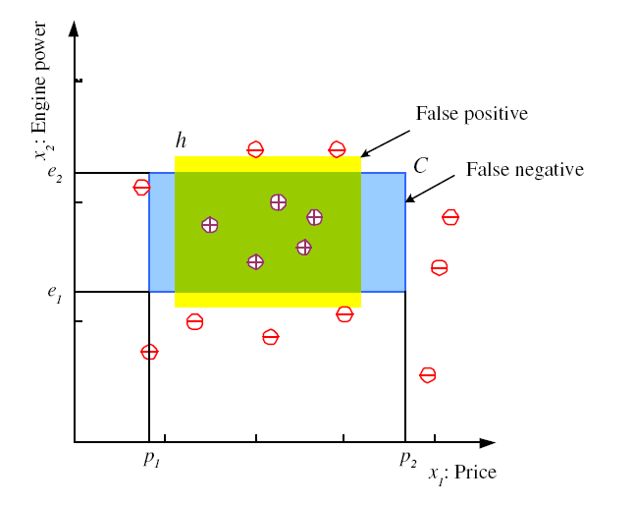
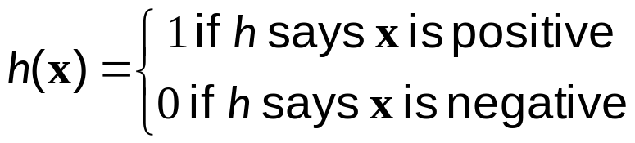
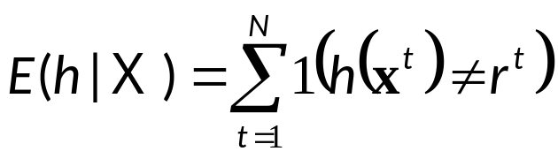
Hypothesis class H
Error of h on H

Slide 37
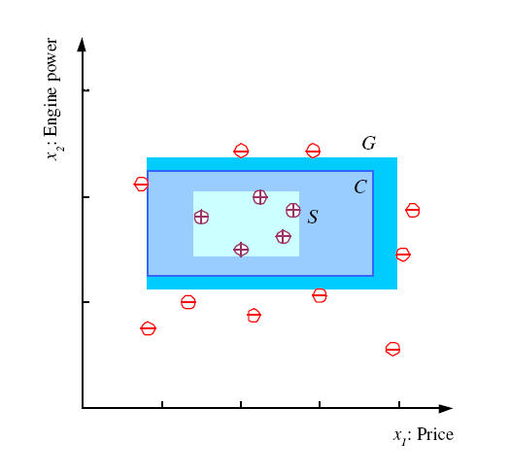
S, G, and the Version Space
most specific hypothesis, S
most general hypothesis, G
h ∈ H, between S and G is
consistent
and make up the
version space
(Mitchell, 1997)

Slide 38
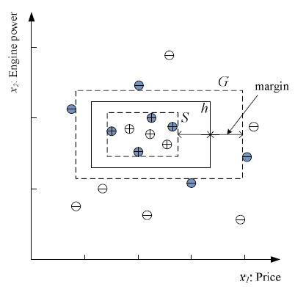
Margin
Choose h with largest margin

Slide 39
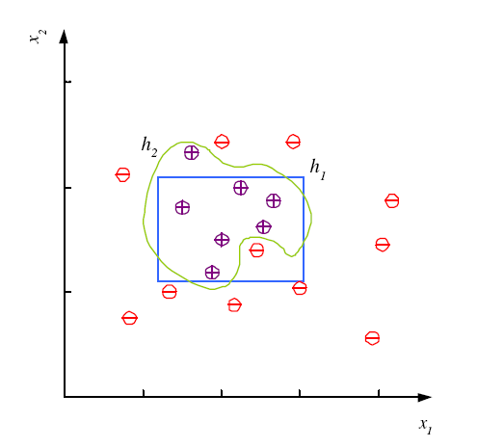
Noise and Model Complexity
Use the simpler one because
Simpler to use
(lower computational
complexity)
Easier to train (lower
space complexity)
Easier to explain
(more interpretable)
Generalizes better (lower
variance - Occam’s razor)

Slide 40
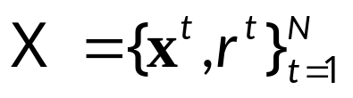
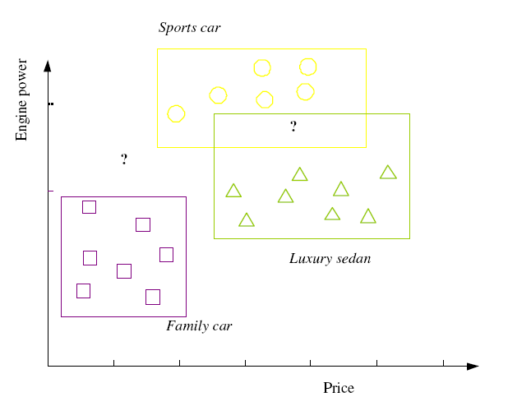
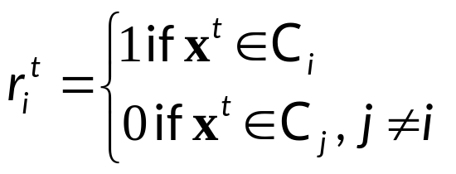

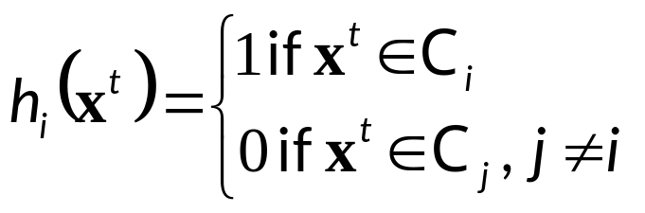
Multiple Classes, C_{i} i=1,...,K
Train hypotheses
h_{i}(x), i =1,...,K:

Slide 41
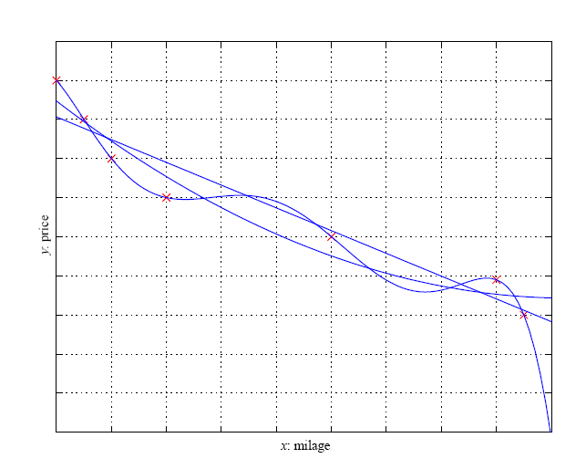
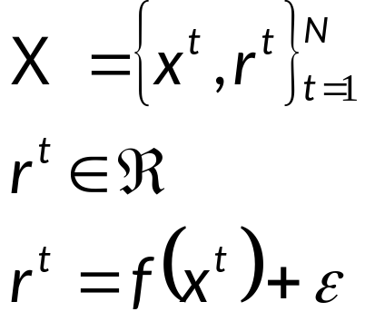

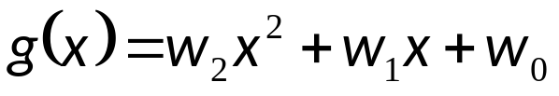
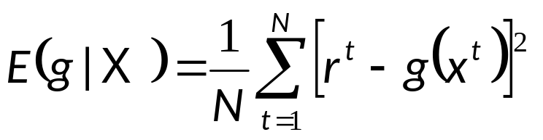
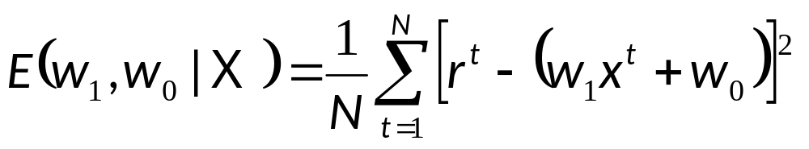
Regression

Slide 42
Cross-Validation
To estimate generalization error, we need data unseen during training. We split the data as
  Training set (50%)
  Validation set (25%)
  Test (publication) set (25%)
Resampling when there is few data

Slide 43
Textbook/ Reference Materials
Introduction to Machine Learning by Ethem Alpaydin
Machine Learning: An Algorithmic Perspective by Stephen Marsland
Pattern Recognition and Machine Learning by Christopher M. Bishop

